Slide 1
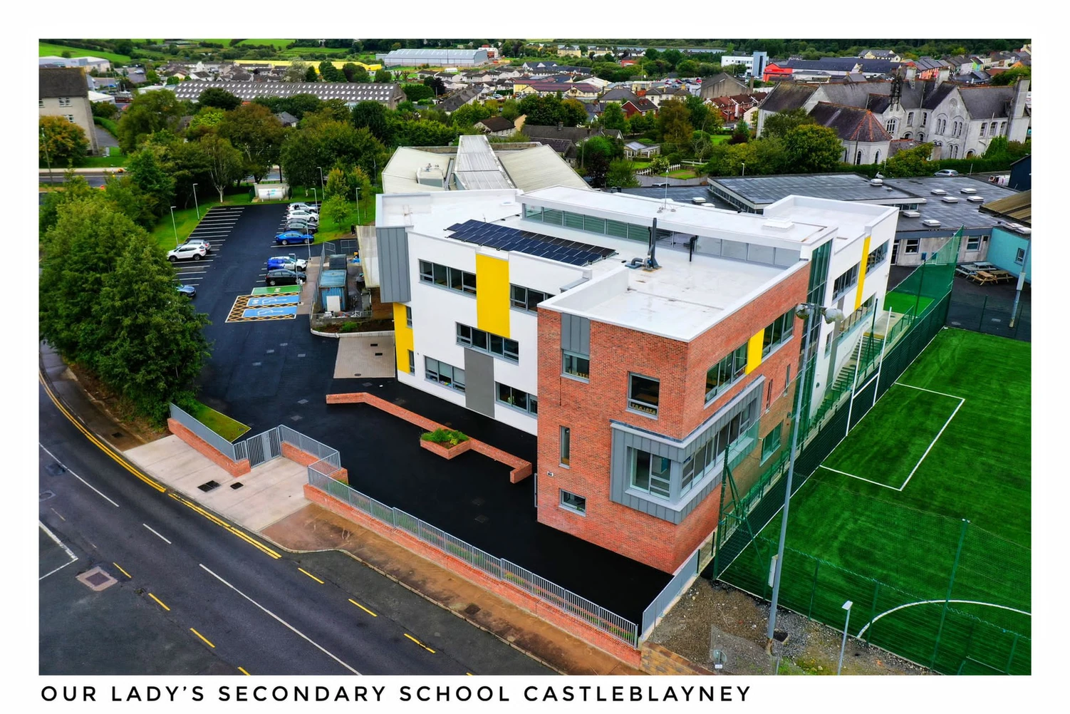






To the Parents / Guardians
of Incoming 1st Years 2027
Our Lady’s Secondary School, Castleblayney

Slide 2
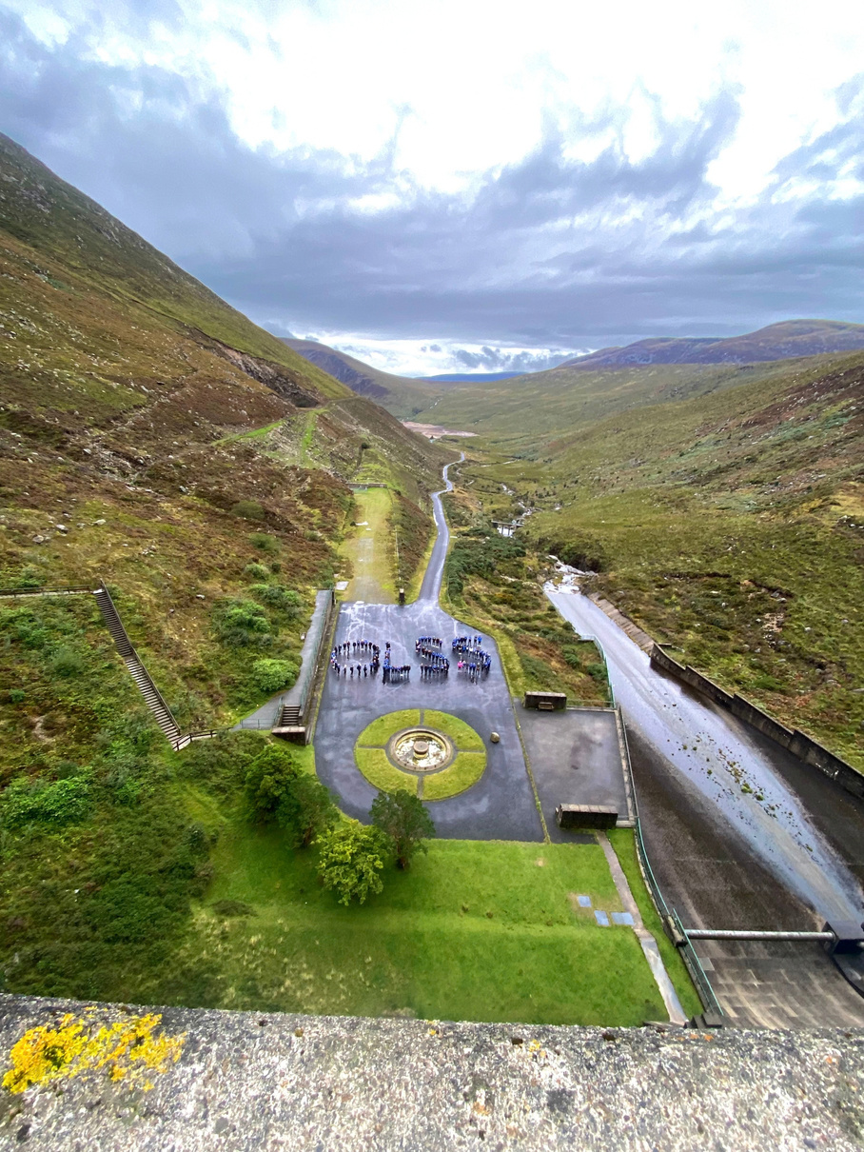


What Our Lady’s offers
    Academics
    Extra Curricular
    Student Support
    Positive Student - Teacher Relationships

Slide 3
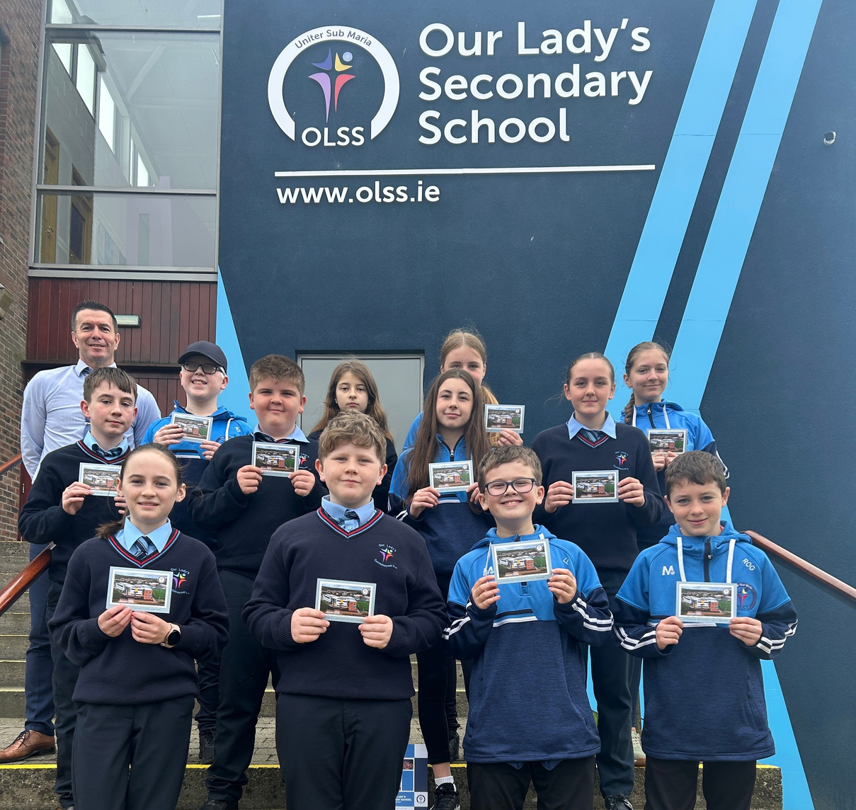

Students are at the centre of all that we do

Slide 4



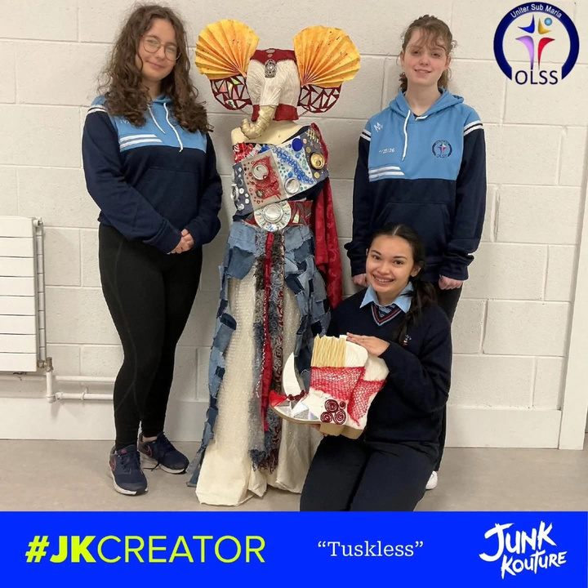
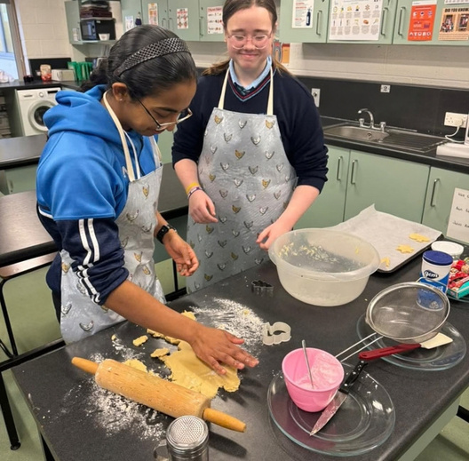
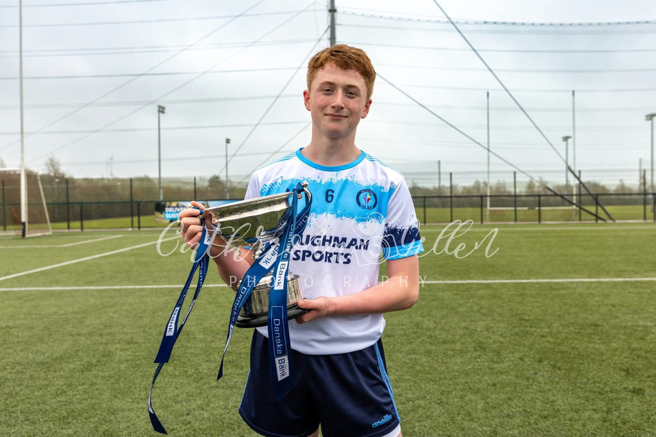
Every Student has in Our Lady’s has
Talent
Skill
Ability

Slide 5


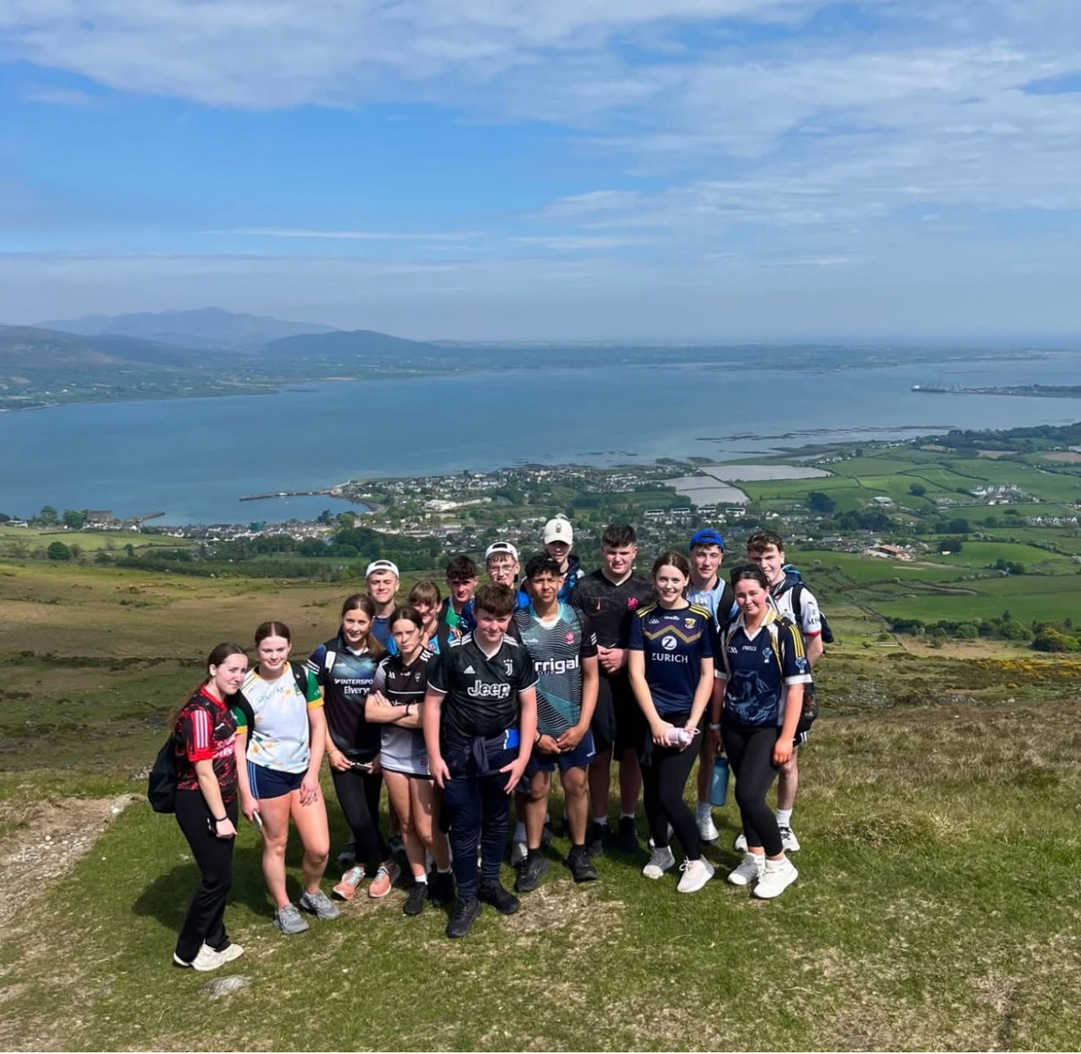

Every student has unique characteristics

Slide 6

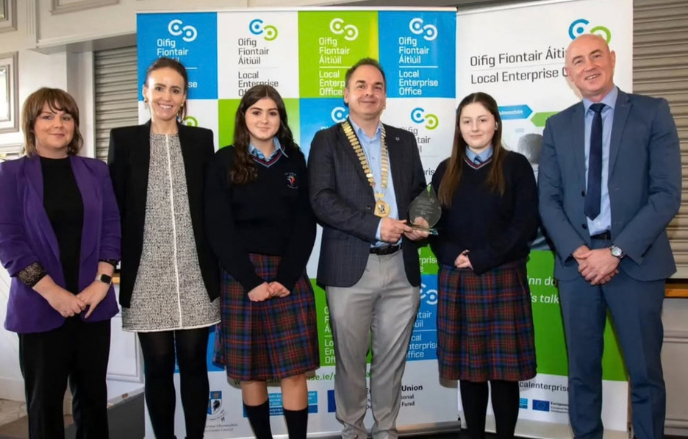

We work closely with parents, teachers and students to develop these talents

Slide 7
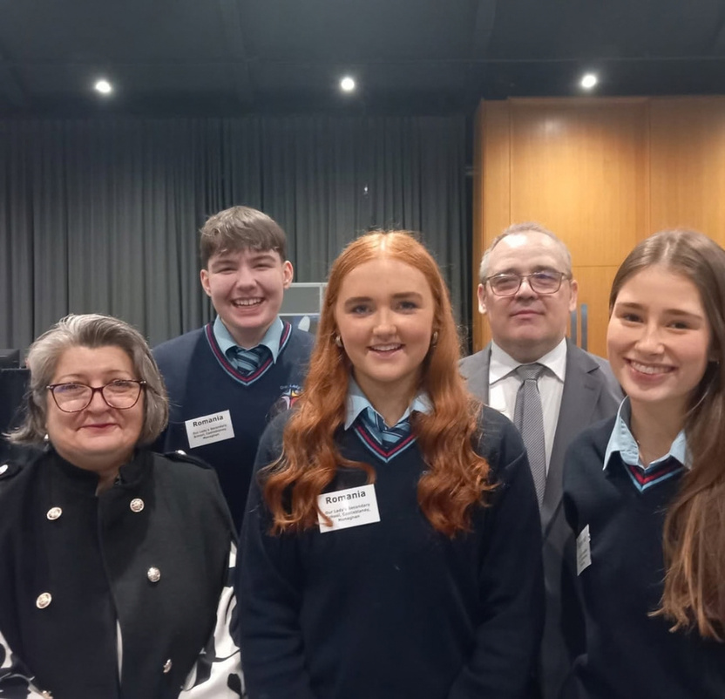
We want our students to:
    Be happy in school
    Content in themselves
    Reach their full potential

Slide 8


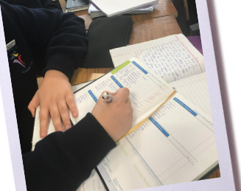

Students of all levels and ability achieve in Our Lady’s

Slide 9



High Standards
Working Hard
Achieving
Success

Slide 10





Progress Tracker
STEN results and Students Primary Passport
Standardised Scores
From attainment Tests
Analyse Junior Cert and Leaving Cert Results
Students always perform and achieve way above what the tests indicate

Slide 11



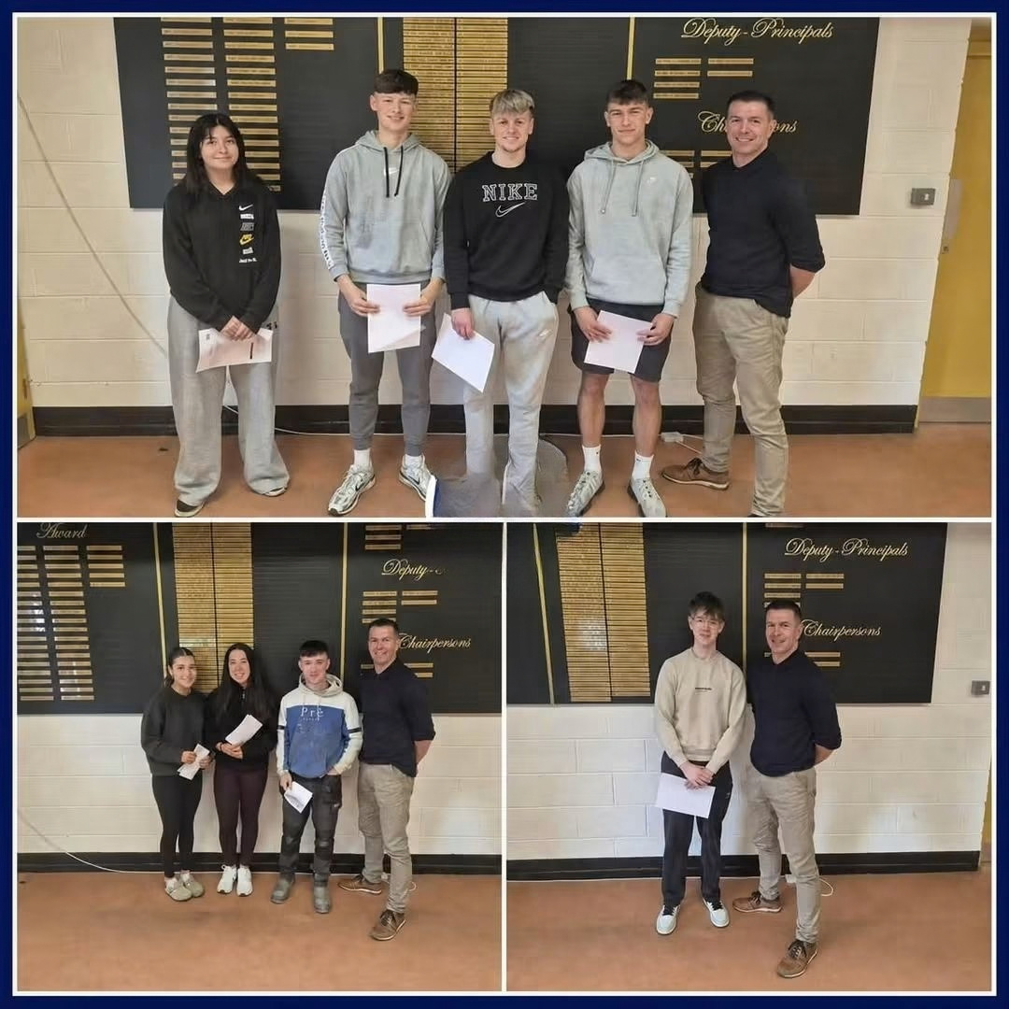
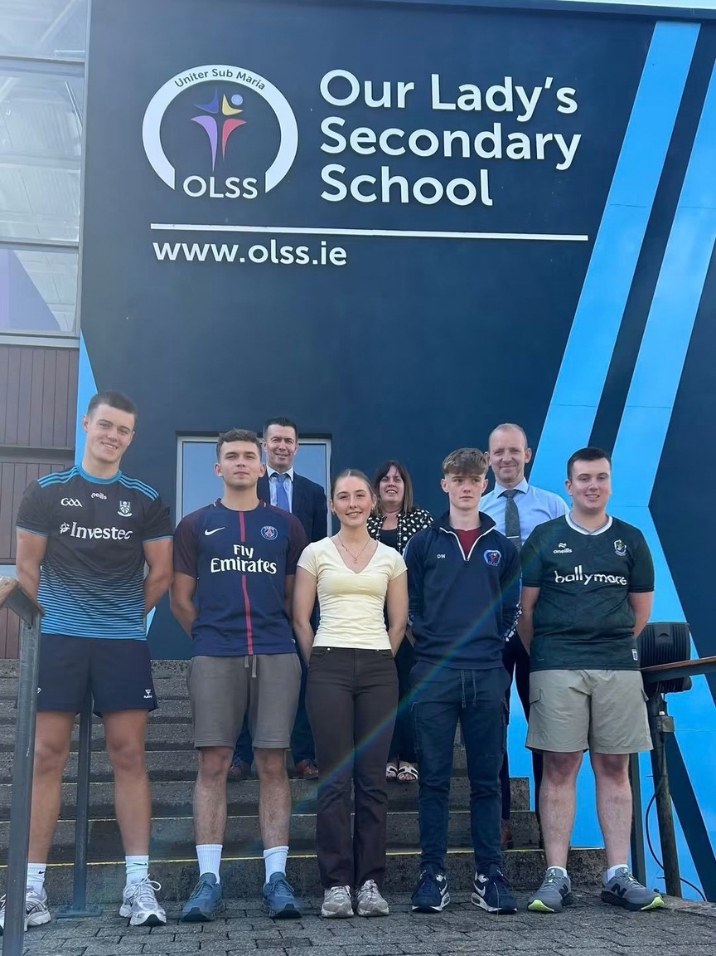
Fantastic Leaving Certificate Results

Slide 12

Leaving Certificate Results 2026
6 Students | Over 600 Points (4 students x 625pts)
11 Students | Between 550-600 Points
10 Students | Between 500-550 Points
46 Students | Between 400- 500 Points
45 Students | Between 350-400 Points

Slide 13
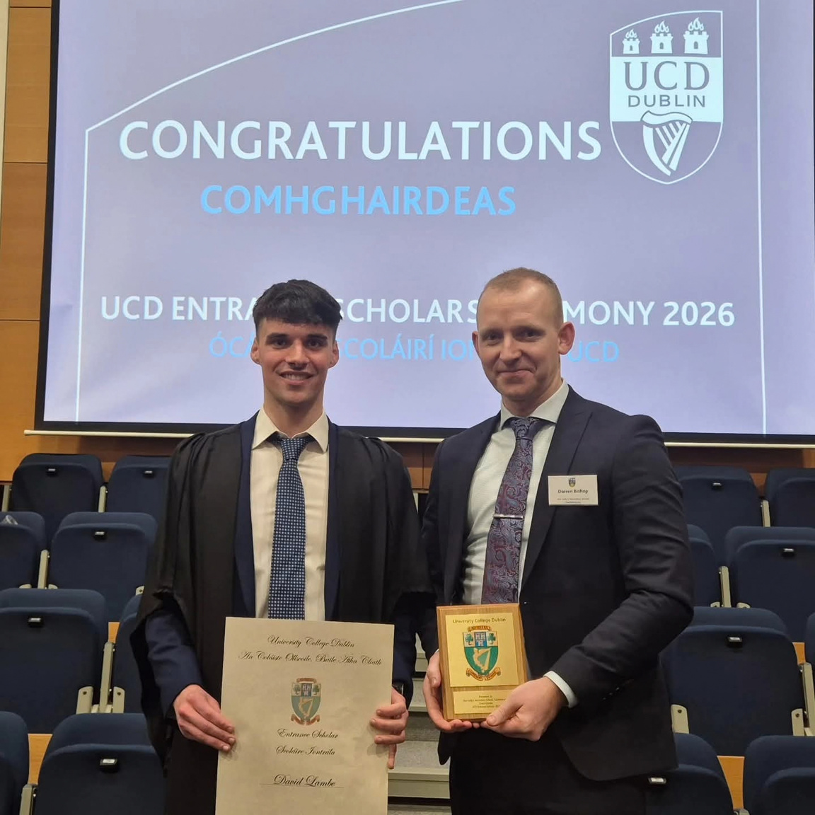
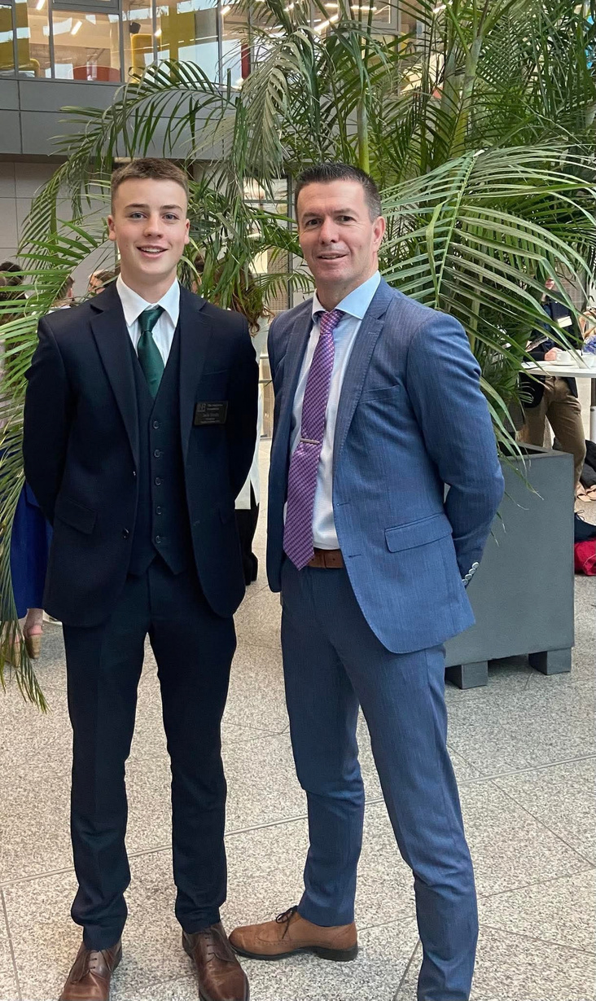
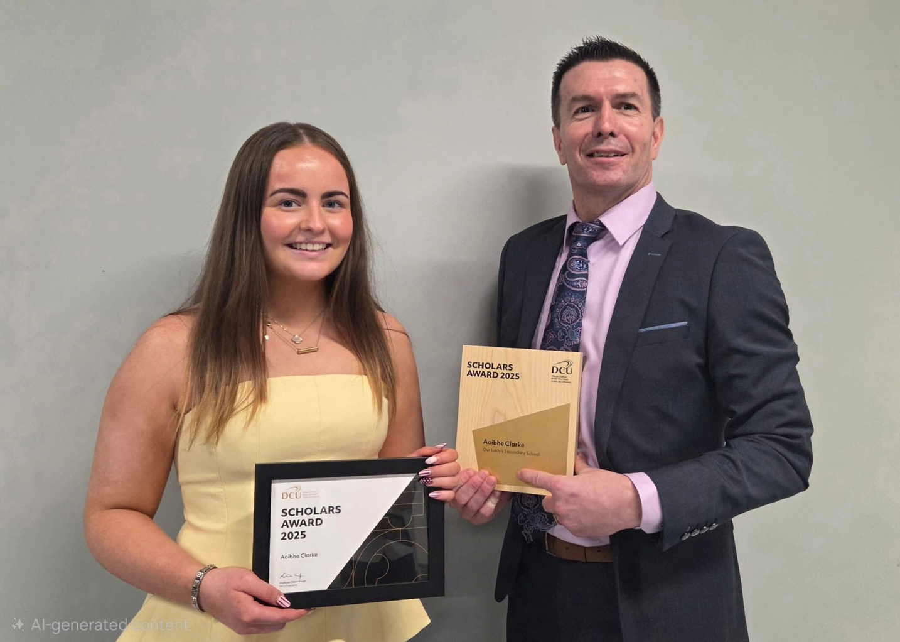
Recent Student Scholarships

Slide 14


A broad and balanced Curriculum

Slide 15
Junior Cycle Subjects
Core Subjects | Choice Subjects
Irish English Maths History Geography Science French or German | Wood Technology Applied Technology Business Art Music Home Economics Graphics

Slide 16

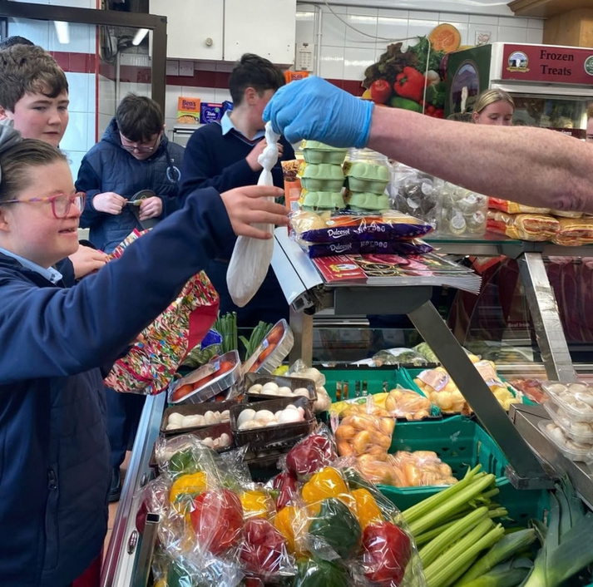


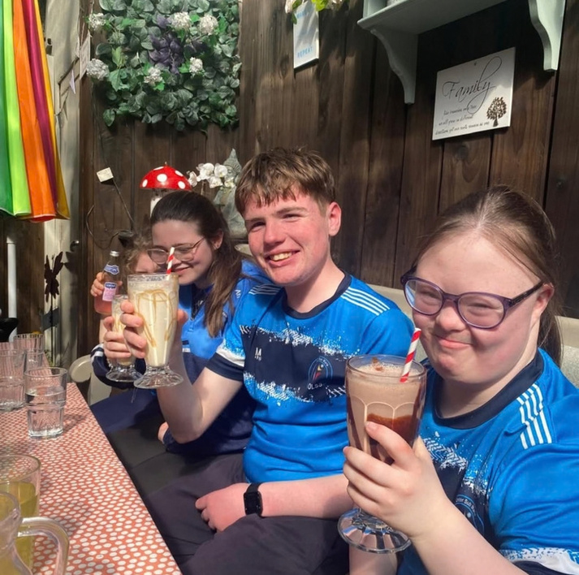
Level 1 + 2 Learning Programmes

Slide 17


Senior Cycle Programmes at Our Lady’s
Leaving Certificate Traditional
Leaving Cert Vocational Programme
Leaving Certificate Applied
Transition Year

Slide 18
Leaving Certificate Subjects
Core Subjects | Choice Subjects | Choice Subjects
Irish English Maths | Biology Chemistry Physics Ag Science Art Music Home Economics History Geography | Accounting Business Economics Politics & Society French German Leaving Cert PE Technology Construction Design Communication Graphics

Slide 19









EXTRA
CURRICULAR

Slide 20
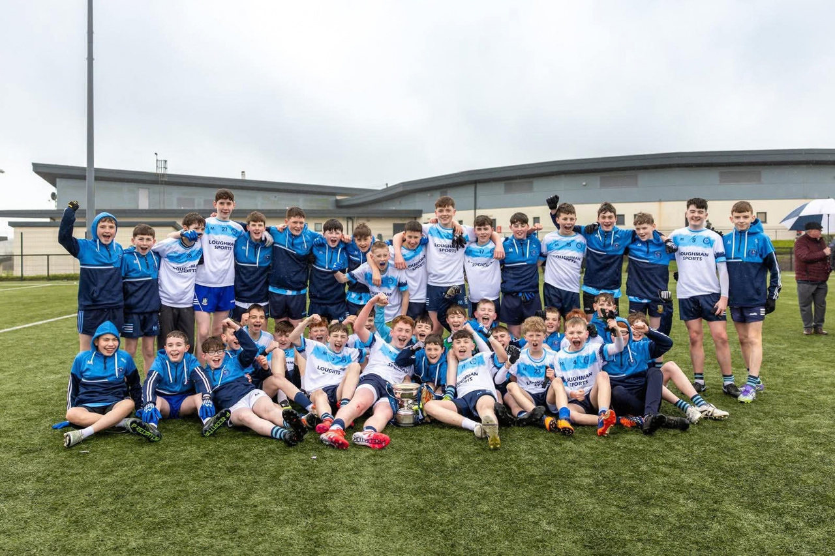
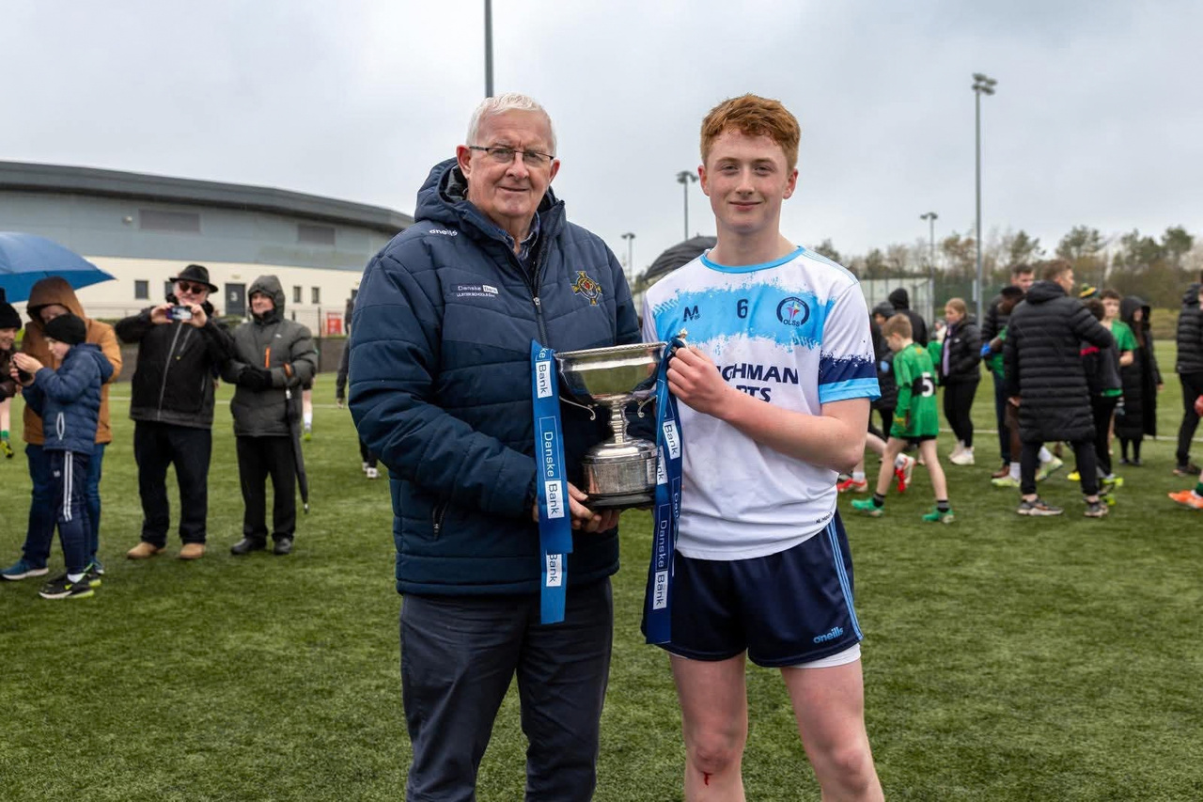
LAST YEARS SUCCESS

Slide 21
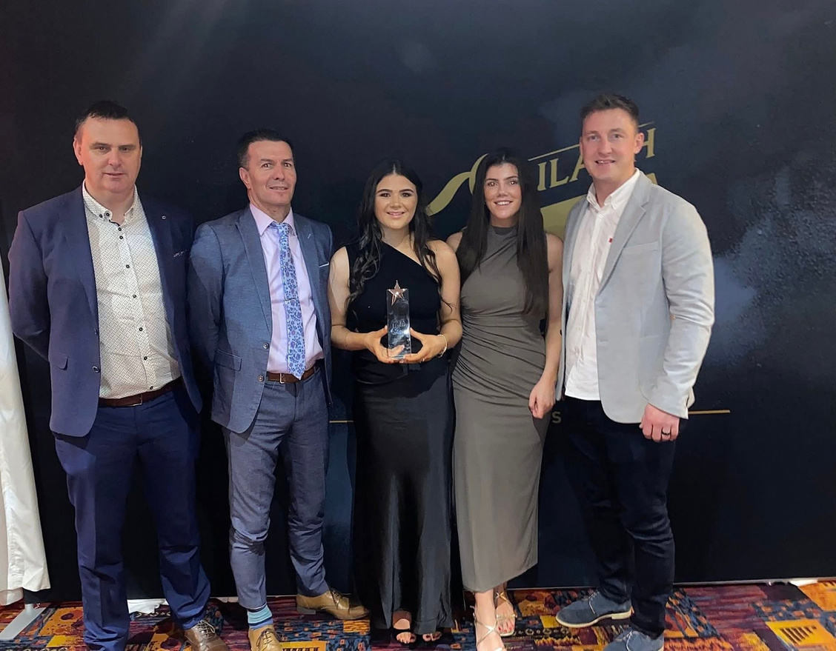

LAST YEARS SUCCESS
All Star 2026
Ladies GAA

Slide 22
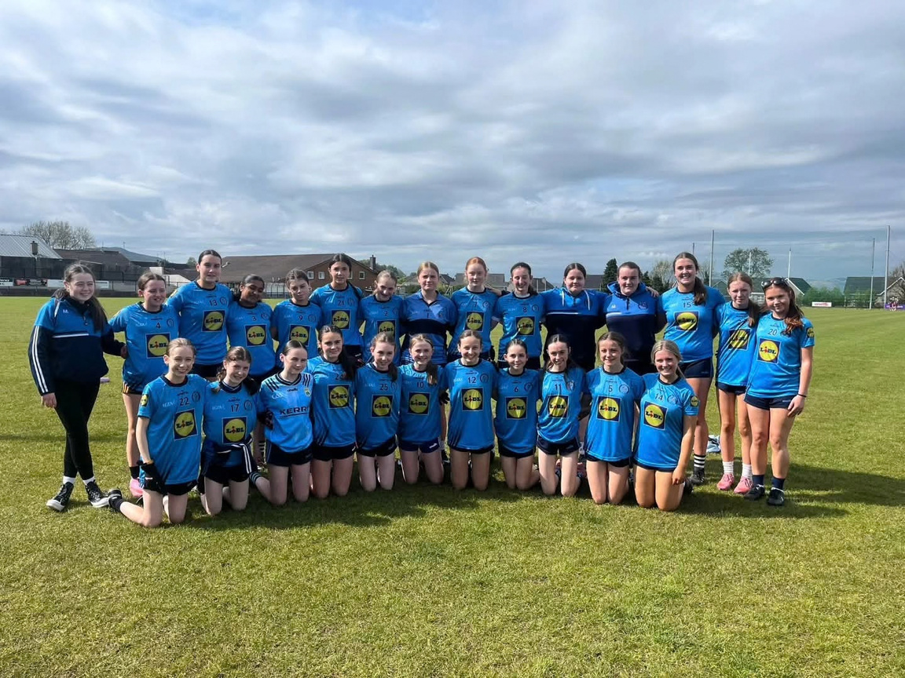
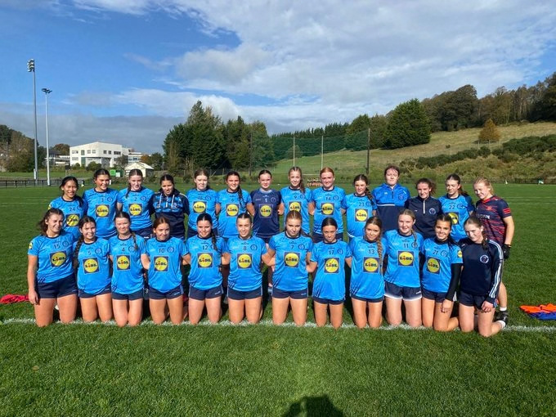
GIRLS GAA

Slide 23
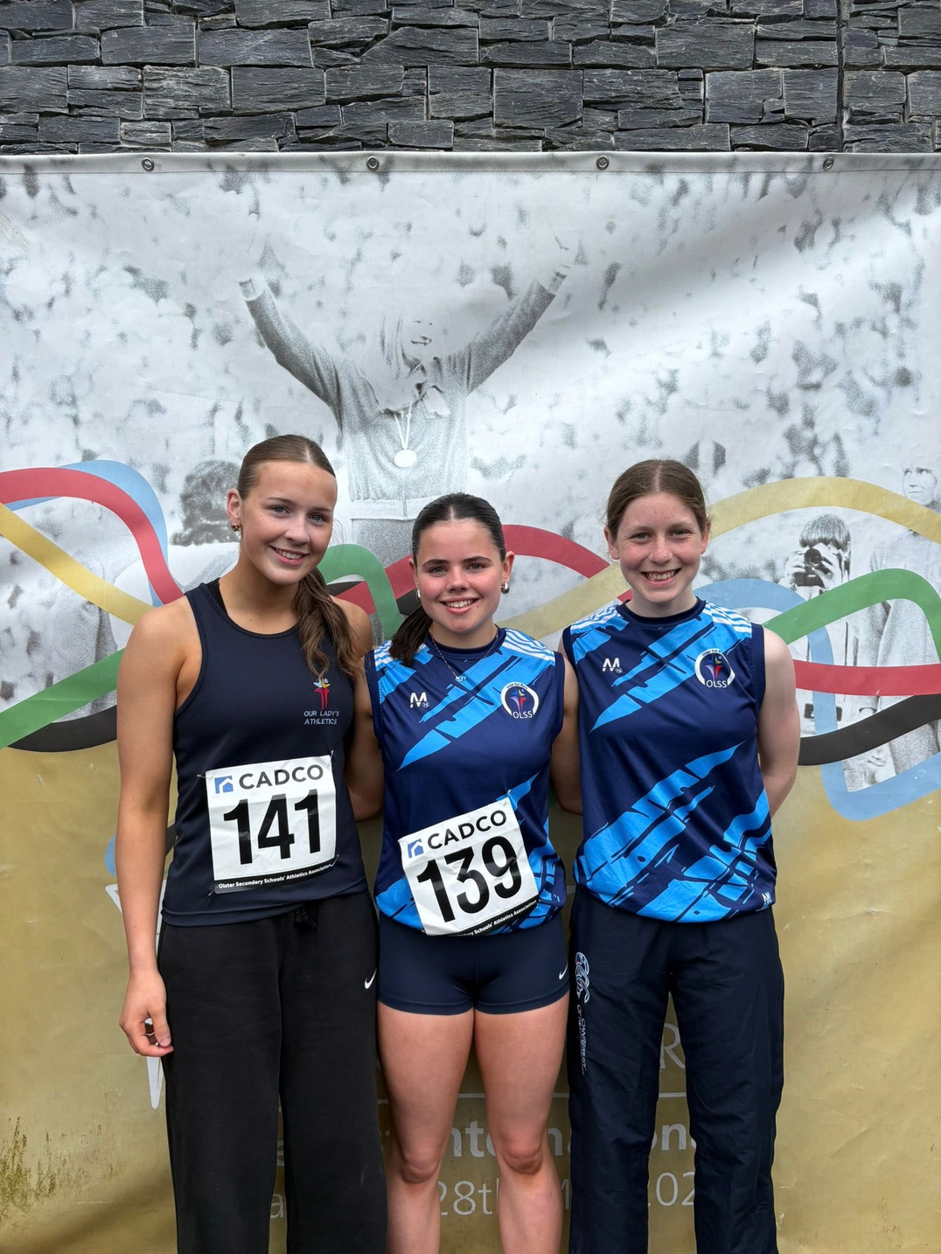
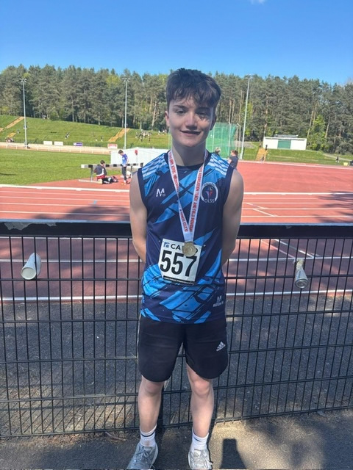
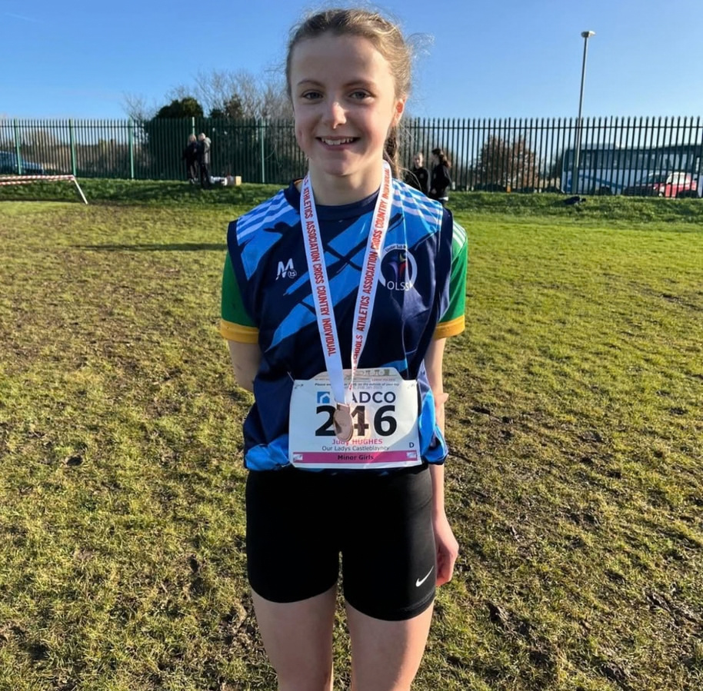
ATHLETICS

Slide 24
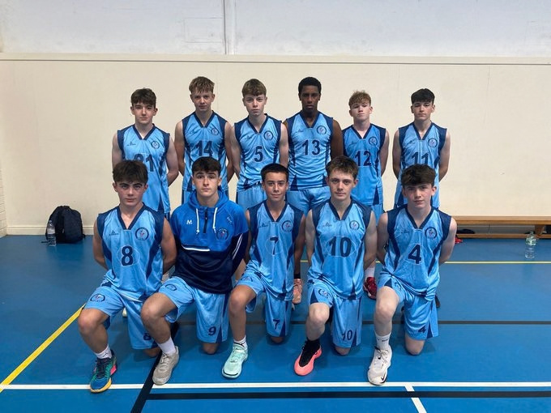
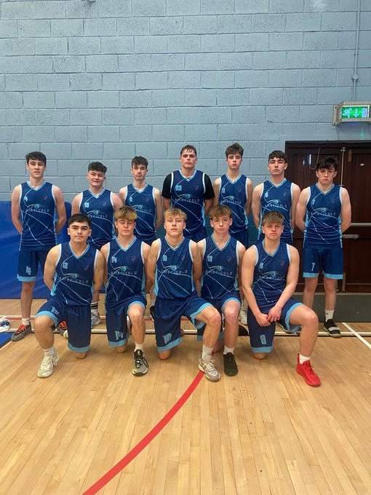
BOYS BASKETBALL

Slide 25
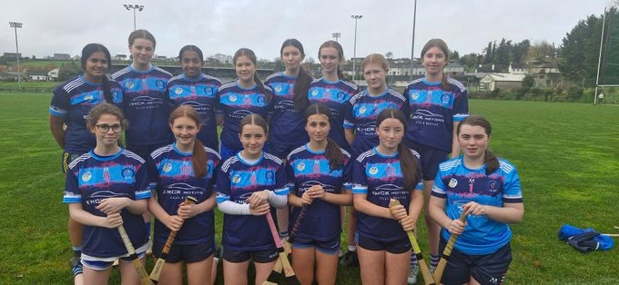
CAMOGIE

Slide 26
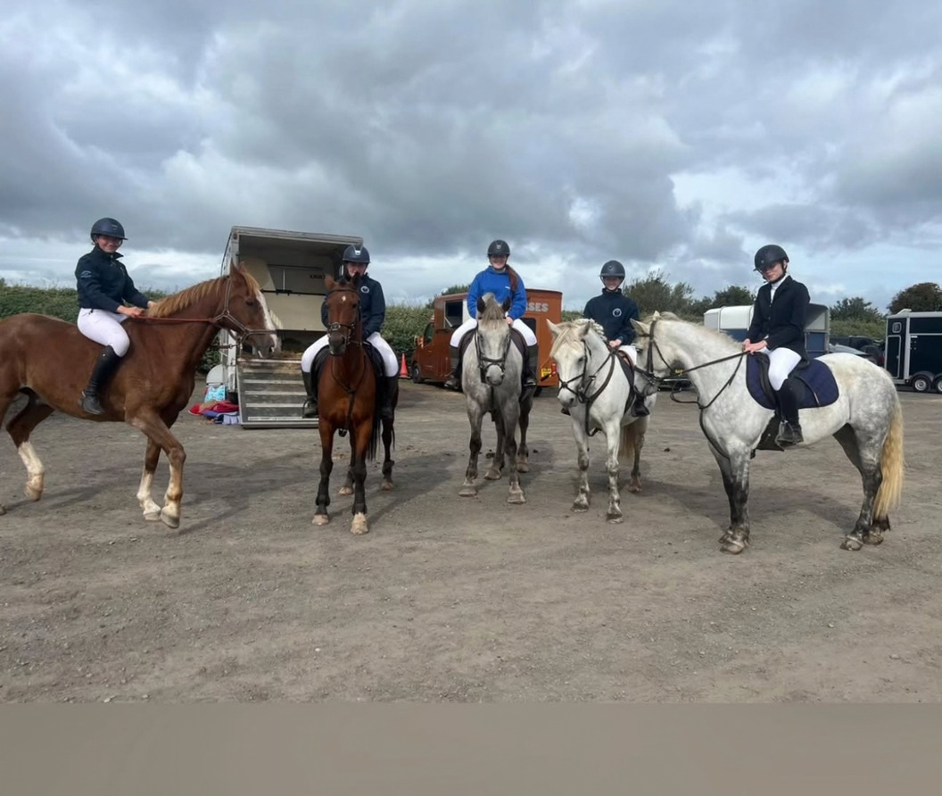
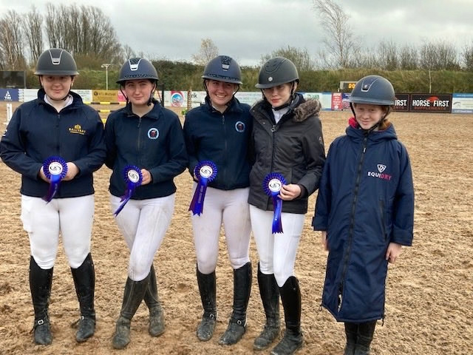
EQUESTRIAN

Slide 27
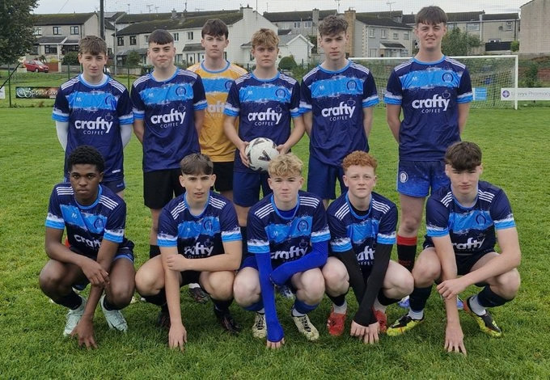
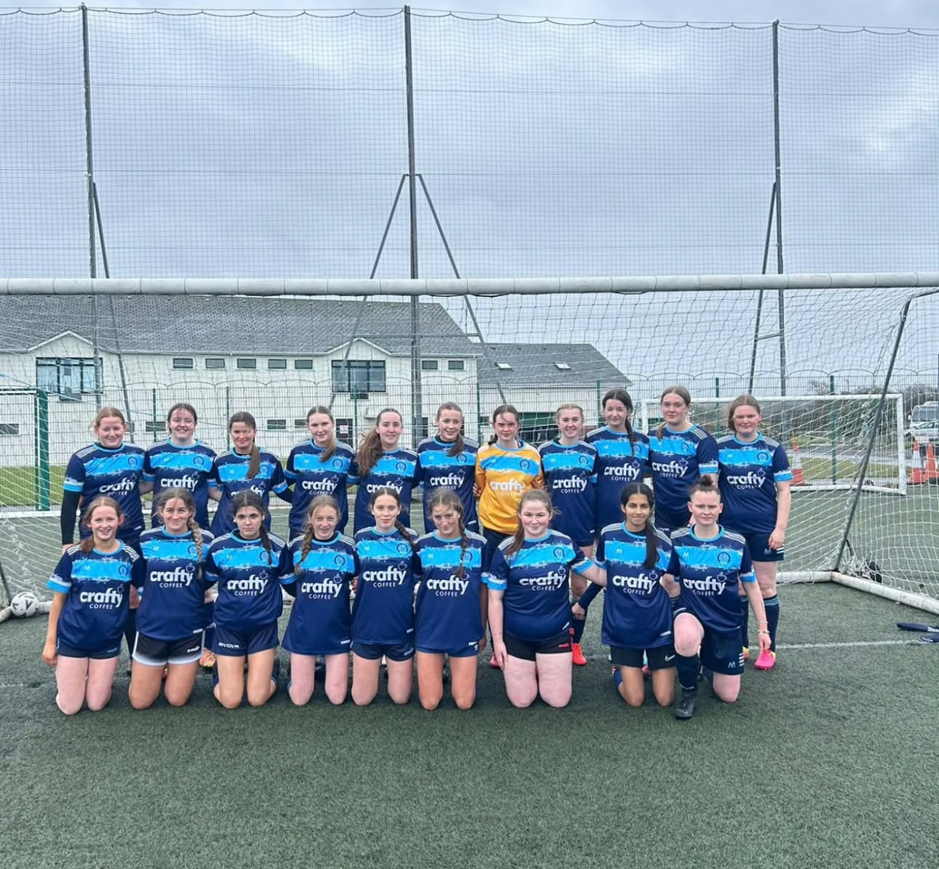
SOCCER

Slide 28
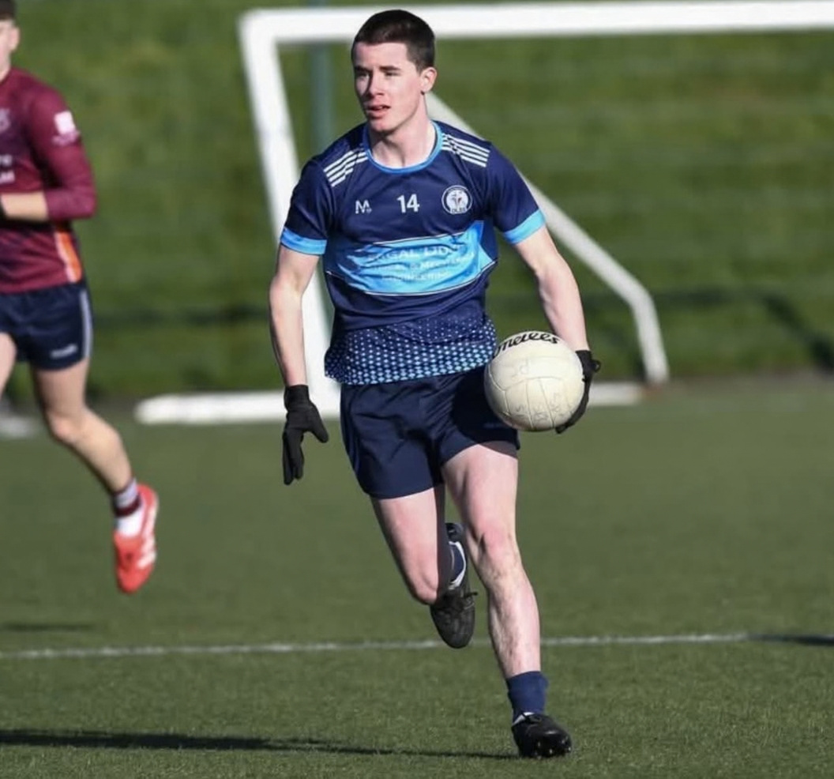
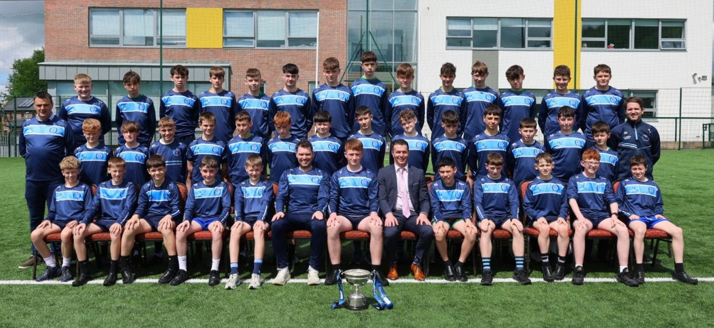
BOYS GAA

Slide 29
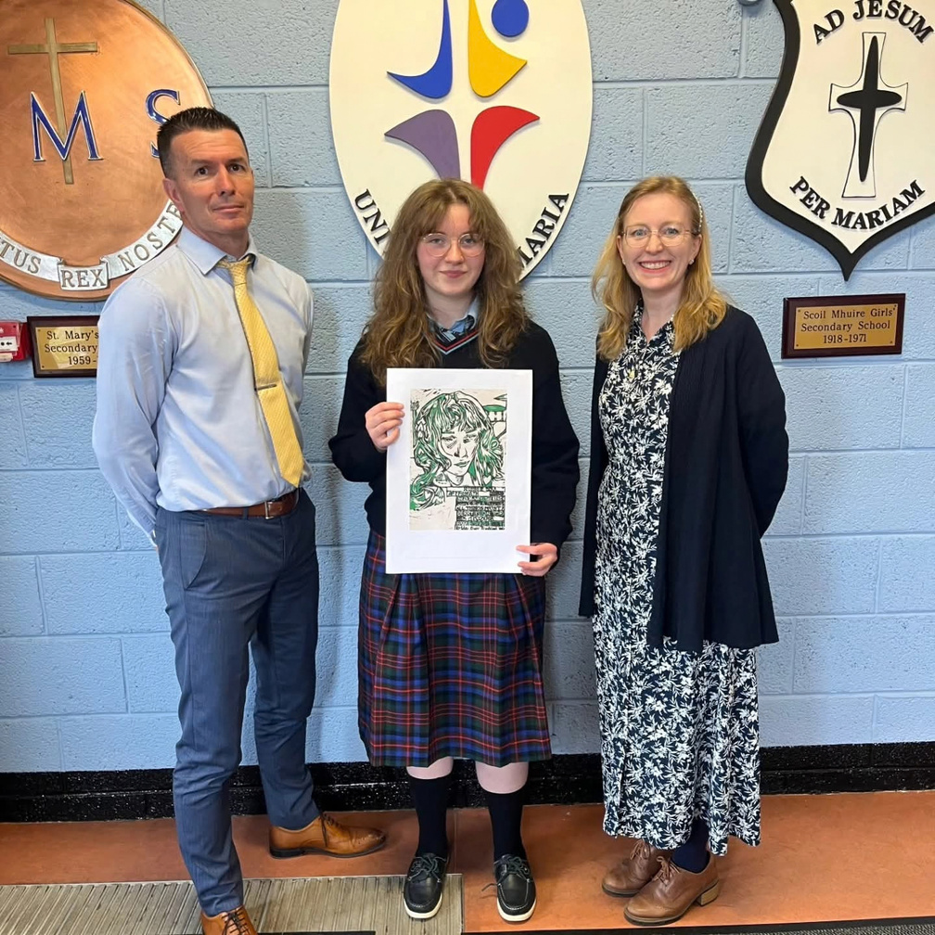
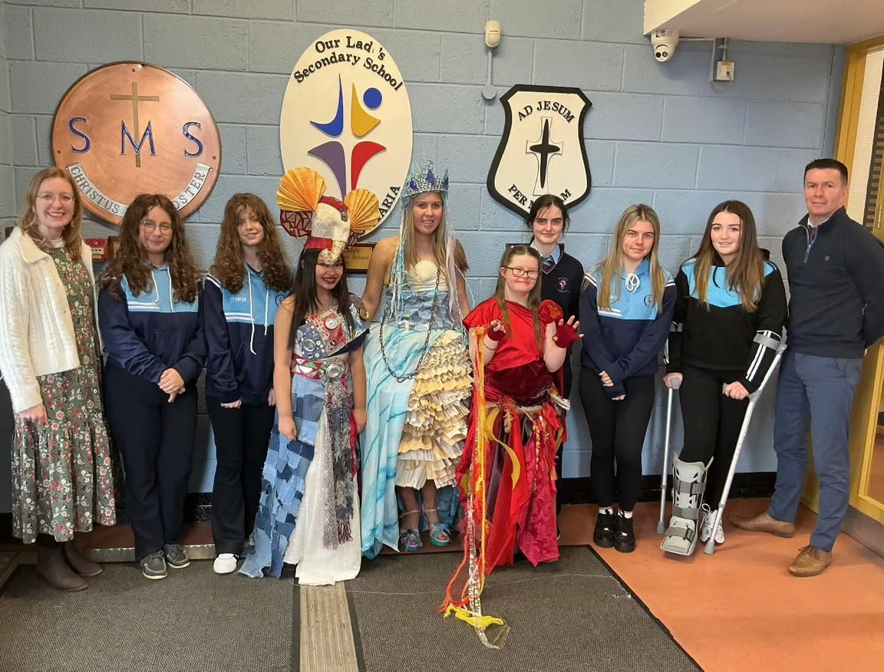
ART + DRAMA

Slide 30
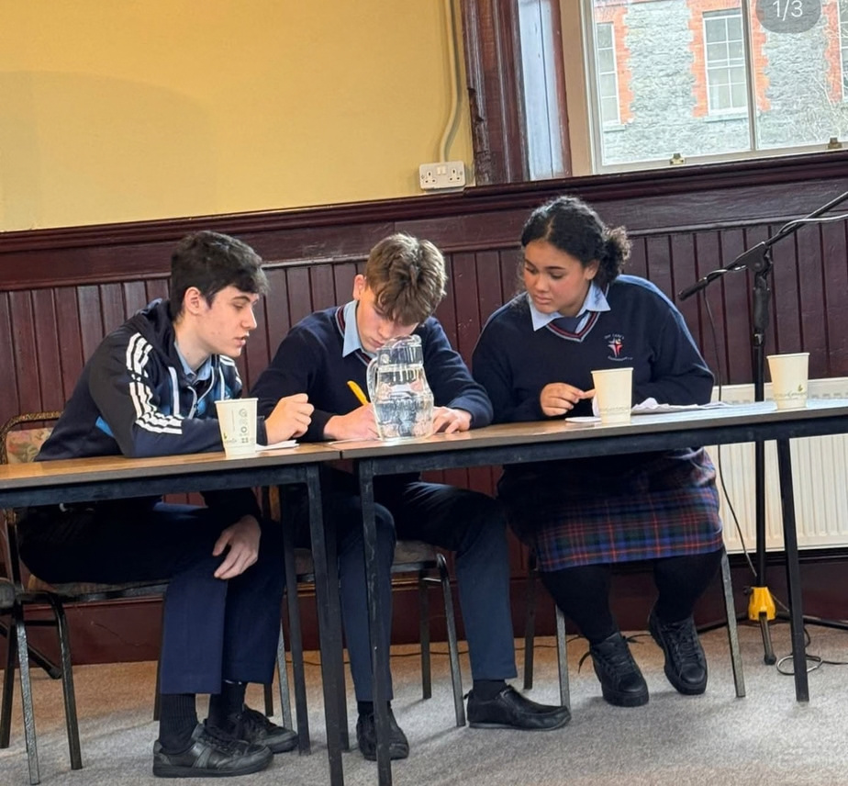
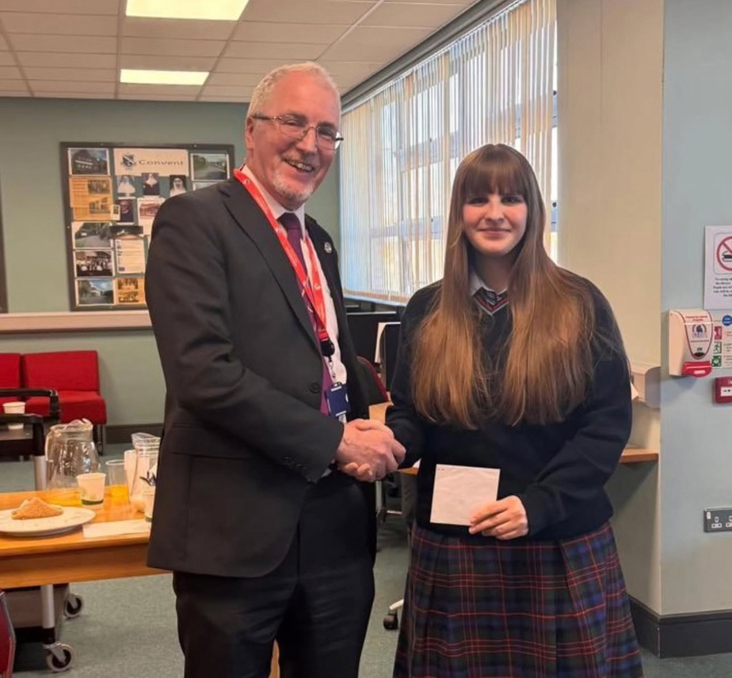
PUBLIC SPEAKING + ESSAY WRITING

Slide 31

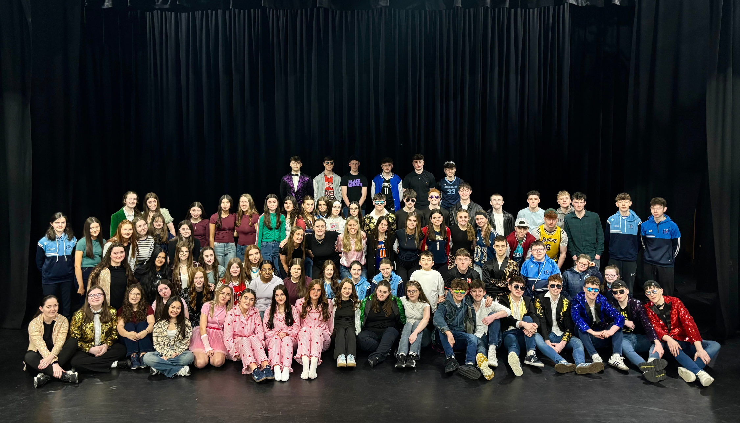
TY MUSICAL

Slide 32
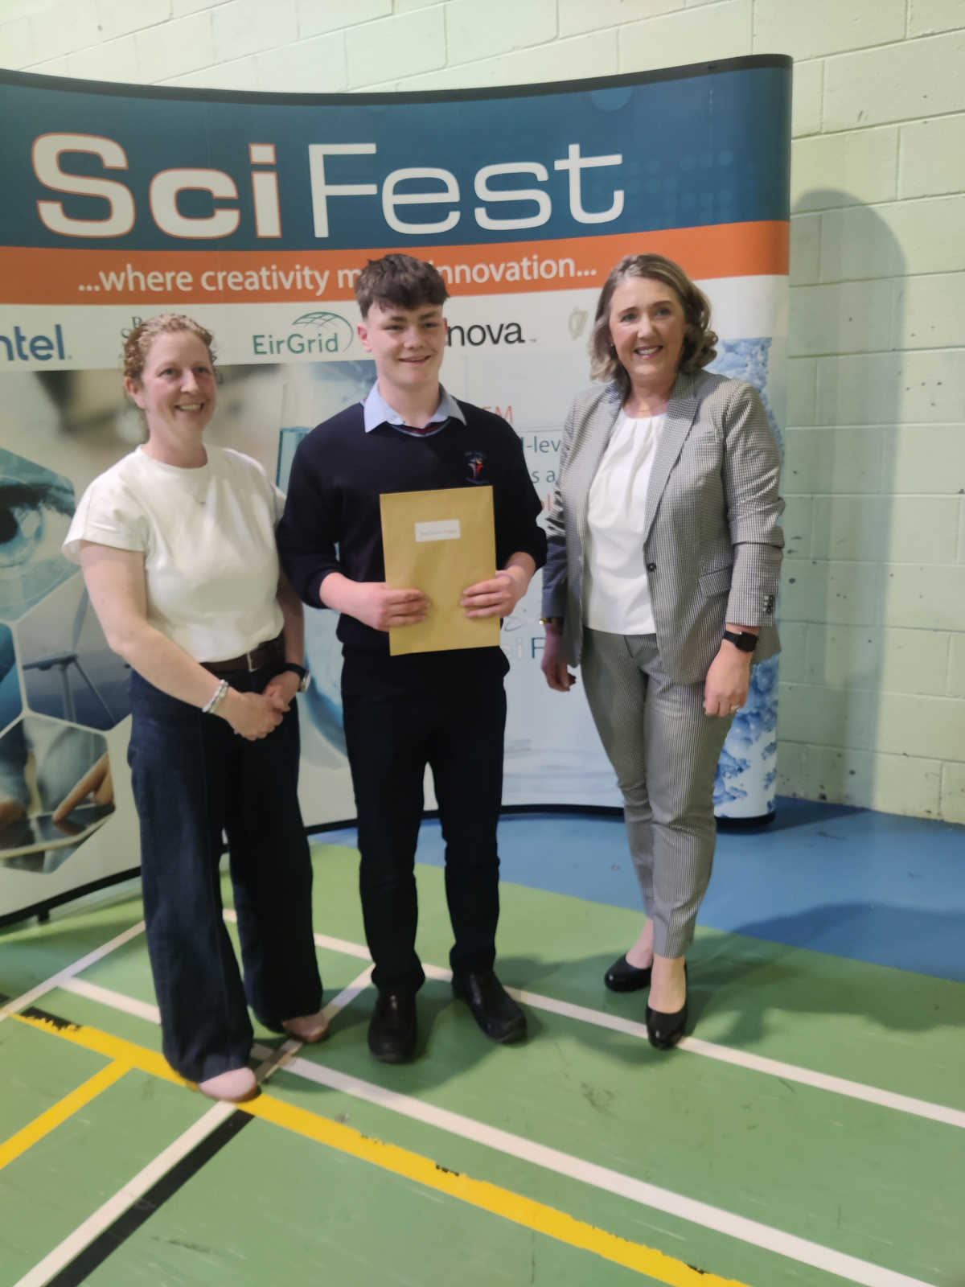
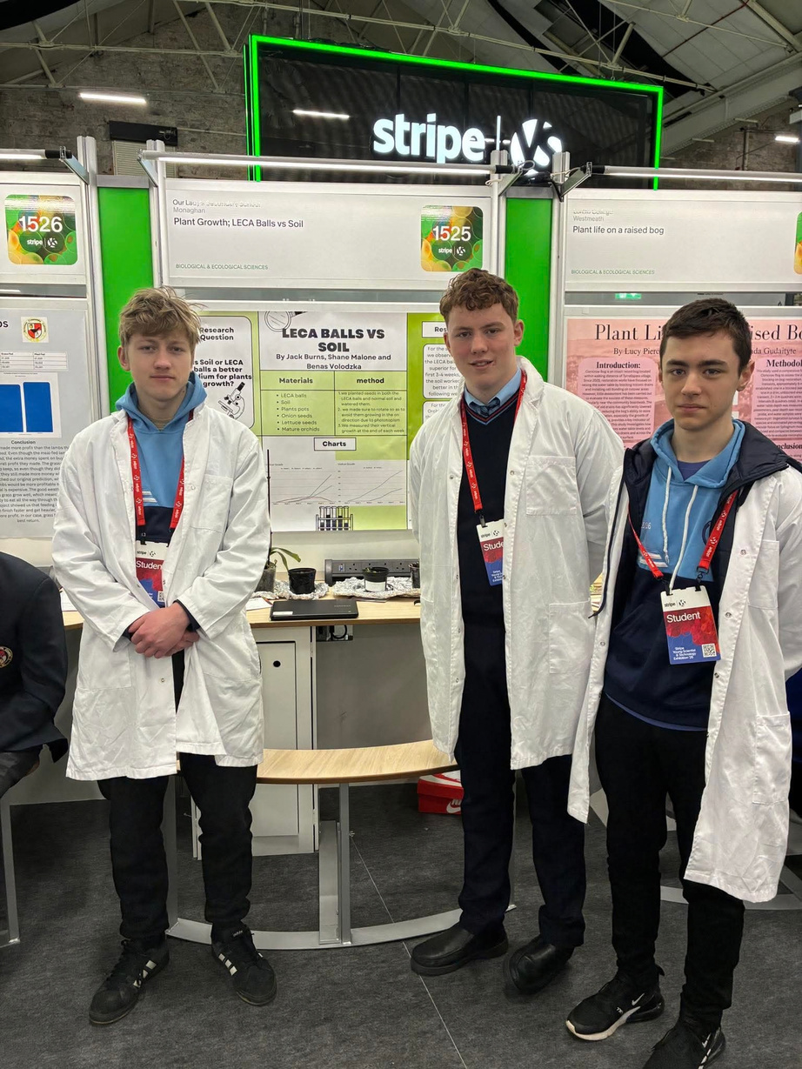
YOUNG SCIENTIST

Slide 33
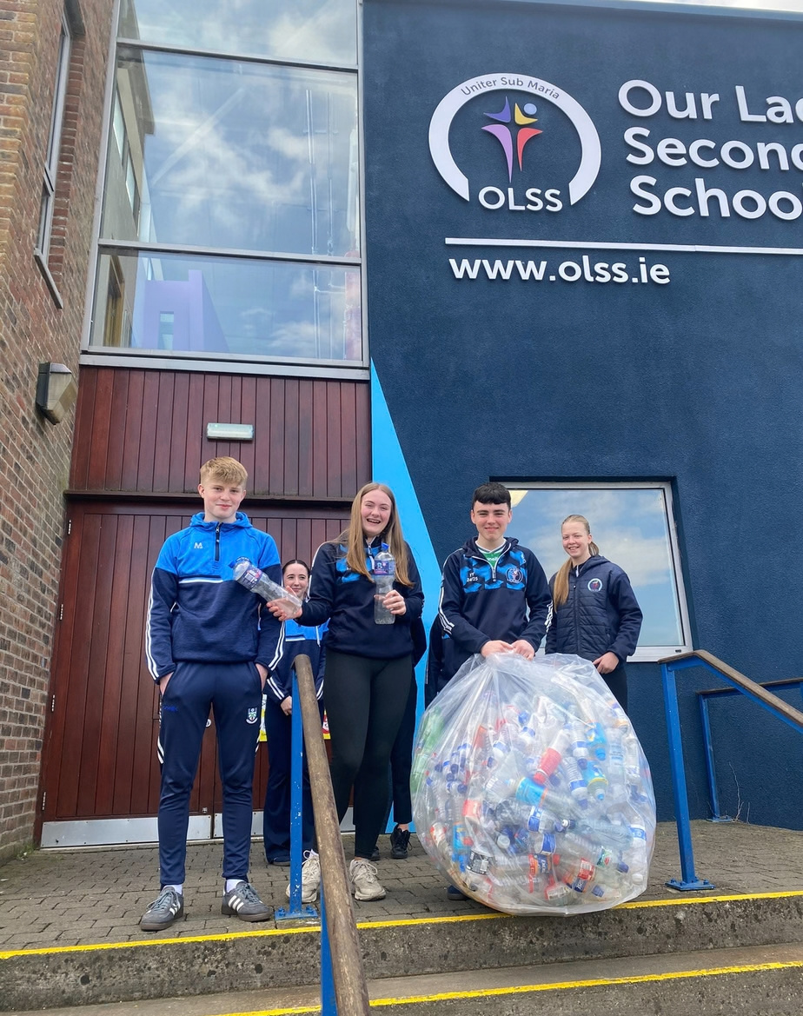

ENVIRONMENTAL / ECO CLUB

Slide 34
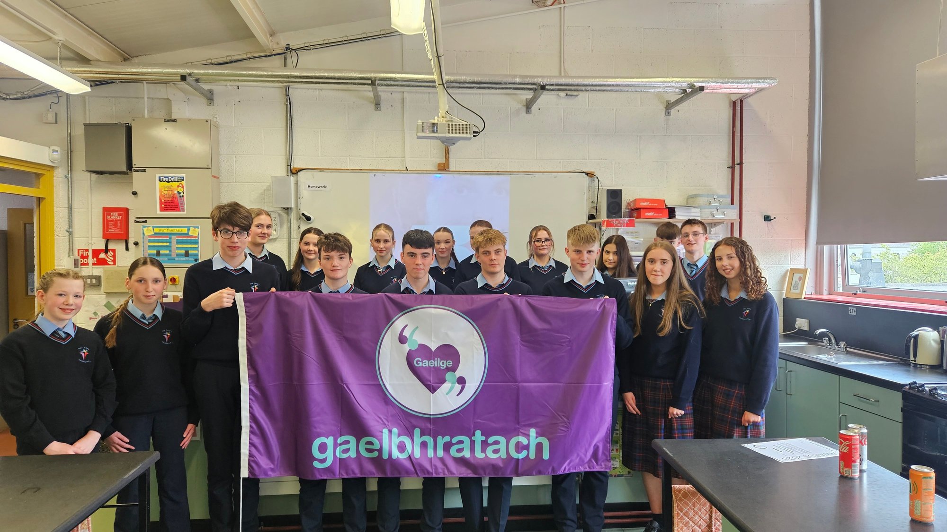


COISTE GAEILGE COMMITTEE

Slide 35
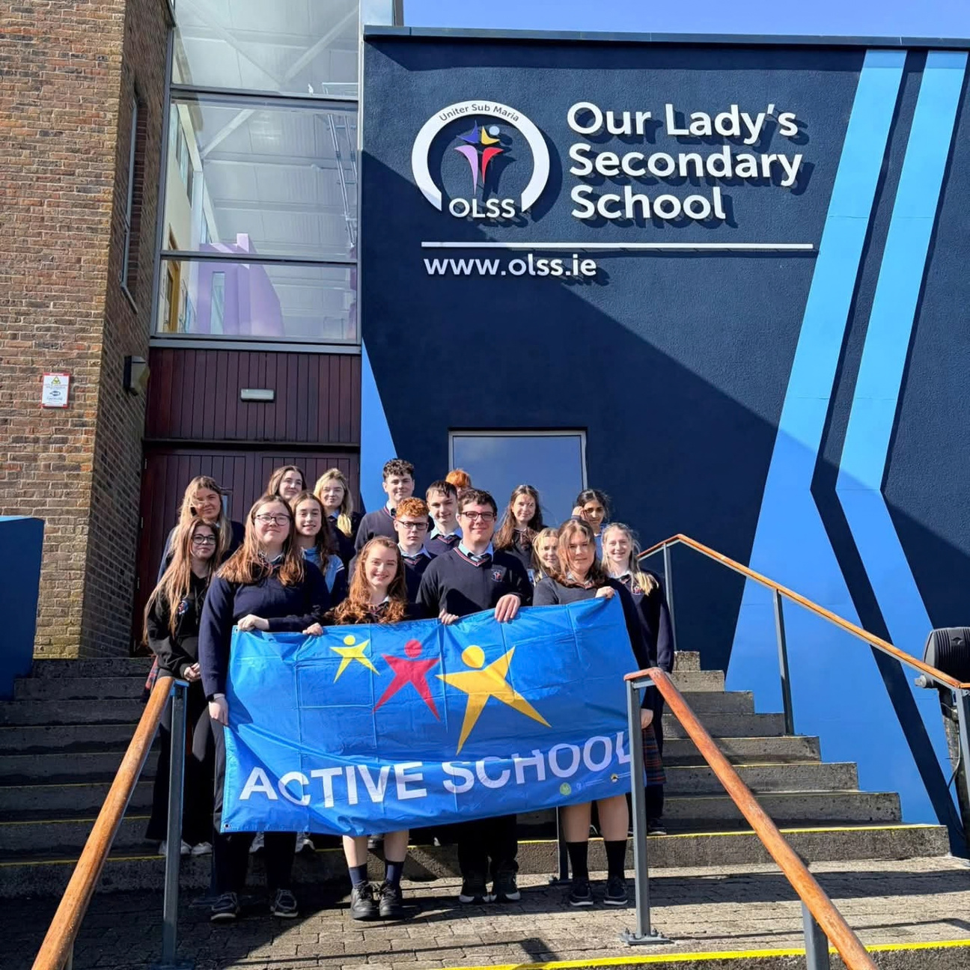


Active Schools Committee

Slide 36
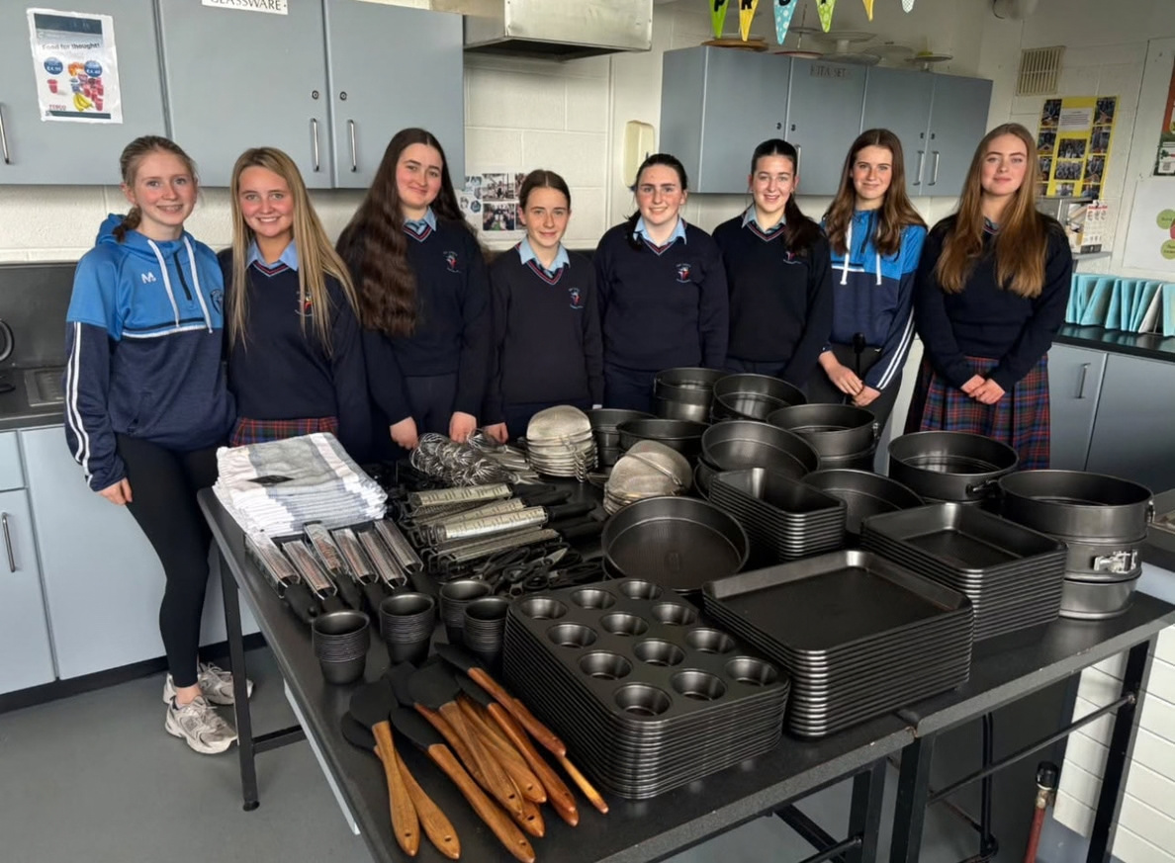
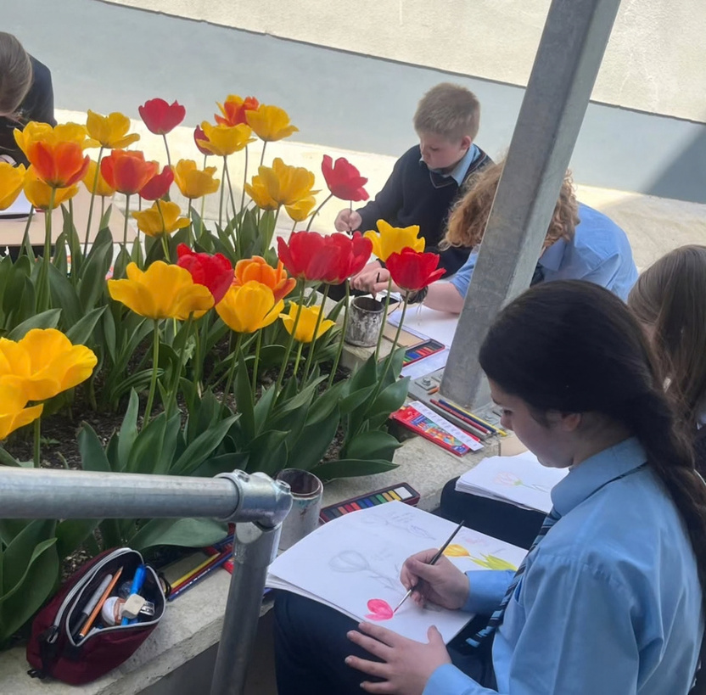
COOKING / ART CLUBS

Slide 37

High Standards
Culture of Working Hard
Happy Staff & Students
Success in Extra Curricular

Slide 38
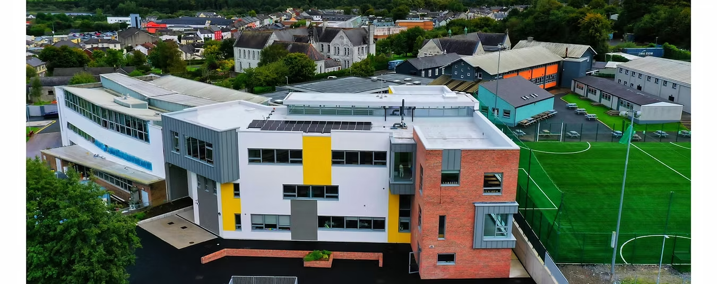
Extension & New Facilities
    Technology Suite
    Art Room
    2 Science Labs
    11 General Classrooms
    Fitness Suite
    Astro Turf Replaces

Slide 39
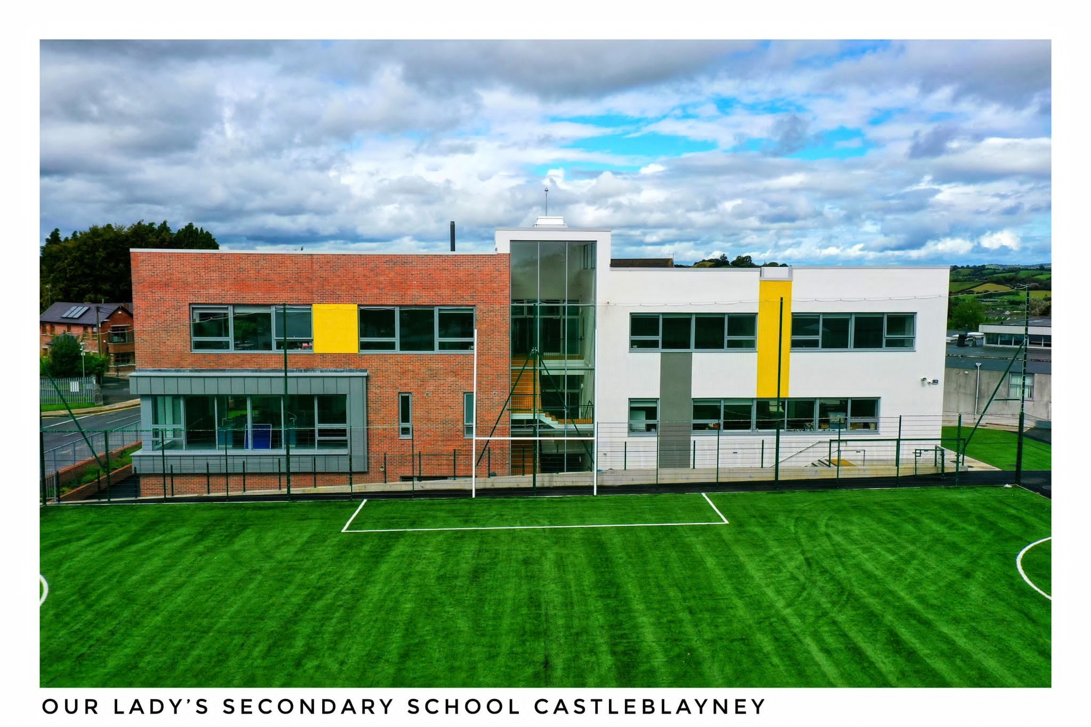

Slide 40
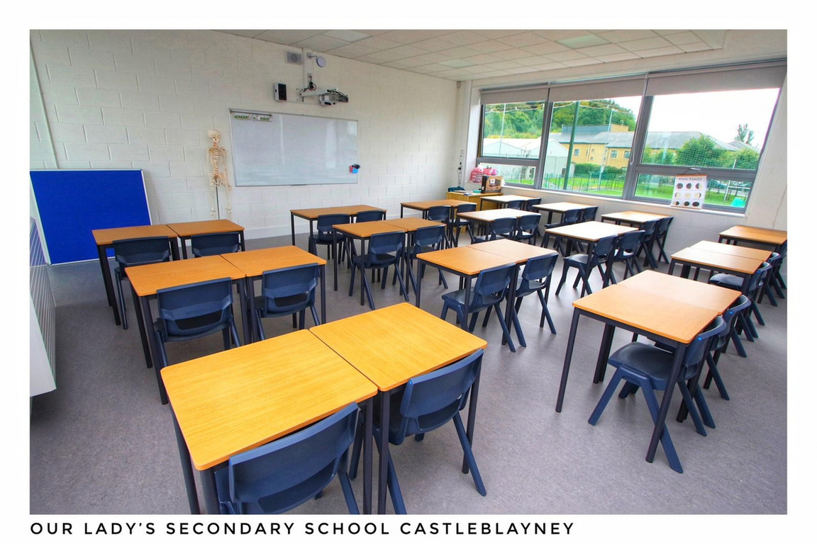
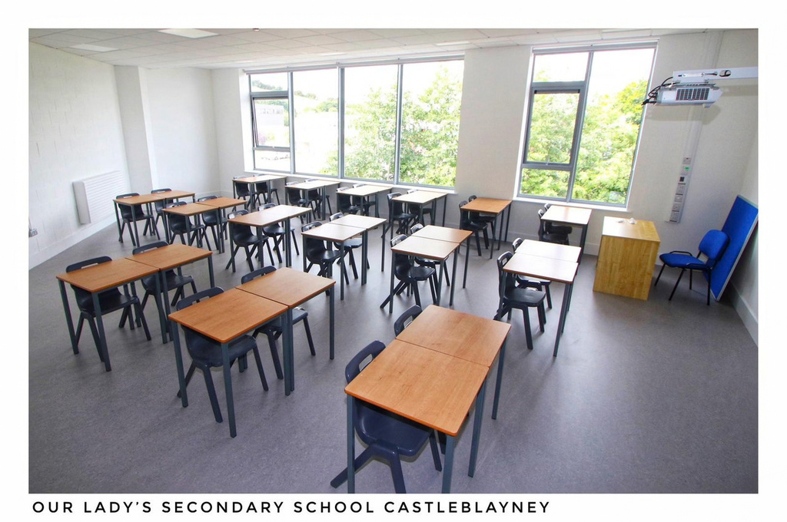
General Classrooms

Slide 41


Technology / Science Labs

Slide 42

Updated Astro Turf

Slide 43

Updated Astro Turf

Slide 44




Fitness Suite

Slide 45




CEIST Ethos + Mercy Traditions
Spiritual wellbeing of our students is very important to us. We foster a culture of:
    High Standards
    Commitment
    Ambition
    Care

Slide 46




Spiritual Reflection

Slide 47


Supporting All Students

Slide 48



Ethos
Care
Compassion
support
For Students

Slide 49


Student Support Structure
    Class Tutor
    Year Head
    Guidance Counsellors
    School Chaplain
    Home School Liaison
    SEN Coordinator
    Check and Connect Programme

Slide 50

Transition from Primary School
Small Class Sizes
All Students Valued
Sampling Subjects

Slide 51
Class Sizes
Classes
First Year Base Class- 24 students Second Year Base Class- 24 students Third Year Base Class-24 students Fifth Year French- 3 classes on 2 option lines Fifth Year Biology- 5 classes on 3 option lines Fifth Year History- 2 classes on 2 option lines Fifth Year Business- 3 classes on 2 option lines Fifth Year German- 2 classes on 2 option lines More teachers gives us more flexibility with the amount of options we can offer our students at Senior Cycle

Slide 52



Induction Process
staff visit to Primary School
educational passport
Open Day
March 2027
Induction Week
August 2027

Slide 53



1st Year Supports
Designated Locker Area
early lunch / break / end of day
Designated section of astro turf
transition from primary discussions
Sampling Subjects

Slide 54


Our greatest strength is people, the people who make up our wonderful school community.

Slide 55


Email office@olss.ie if you have any queries on Enrolment

